Slide 1
ENGINEERING GRAPHICS 1
CLASS 4: PROJECTION OF PLANES 1
(SHEET 4)

Slide 2
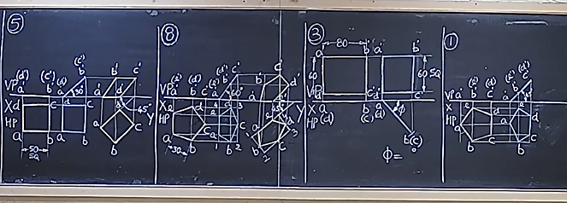

Slide 3
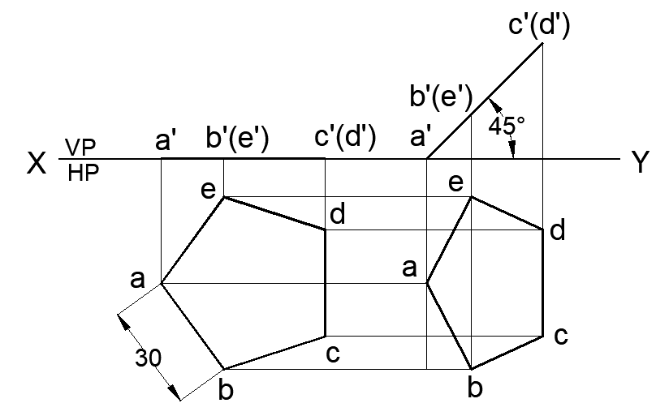
QUESTION BANK: PROJECTION OF PLANES - PROBLEM 1
A regular pentagonal lamina of sides 30 mm is resting with one of its corners such that the two sides passing through that corner make equal inclinations with HP while the surface is perpendicular to VP. The lamina is inclined at 45° to HP. Draw its projections.

Slide 4
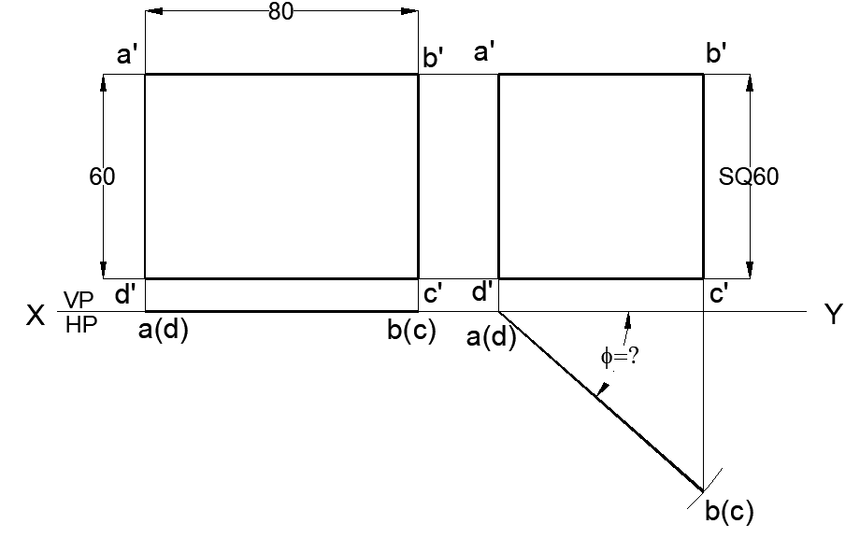
QUESTION BANK: PROJECTION OF PLANES - PROBLEM 3
The surface of a mirror of 60 mm × 80 mm is inclined to the wall and perpendicular to floor such that its front view is a square of 60 mm side. Draw the projections and find the inclination of the mirror to the wall.

Slide 5
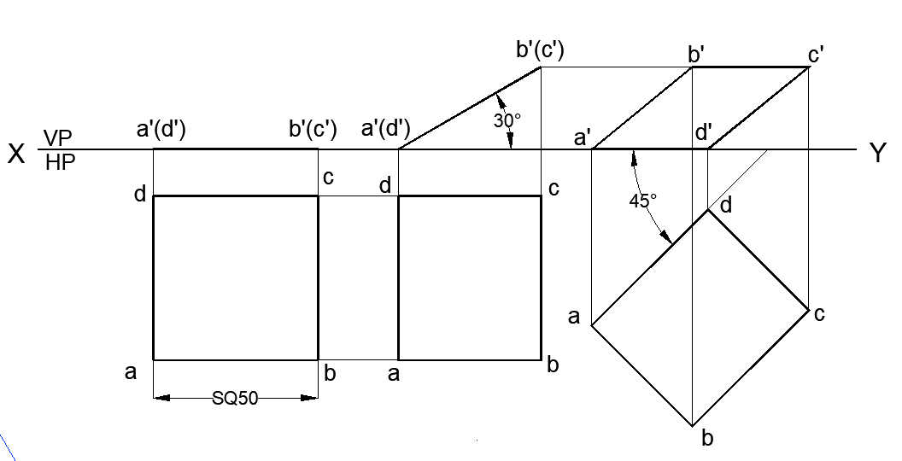
QUESTION BANK: PROJECTION OF PLANES - PROBLEM 5
A square lamina of 50 mm edge rests on one of its sides on HP. The lamina makes 30° with HP and the side on which it rests makes 45° to VP. Draw its projections.

Slide 6
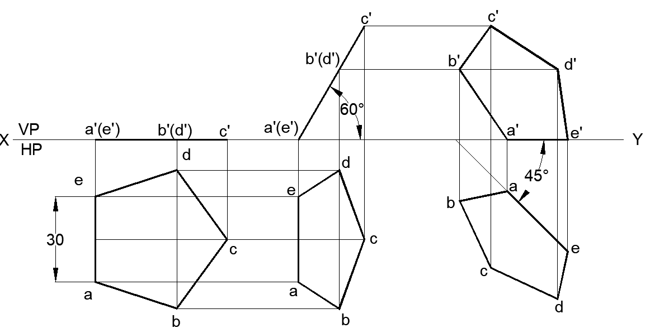
QUESTION BANK: PROJECTION OF PLANES - PROBLEM 8
A pentagonal lamina of sides 30 mm is resting on HP with one of its sides, such that the surface makes an angle of 60° with HP. The edge on which it rests is inclined at 45° to VP. Draw its projections.

Slide 7
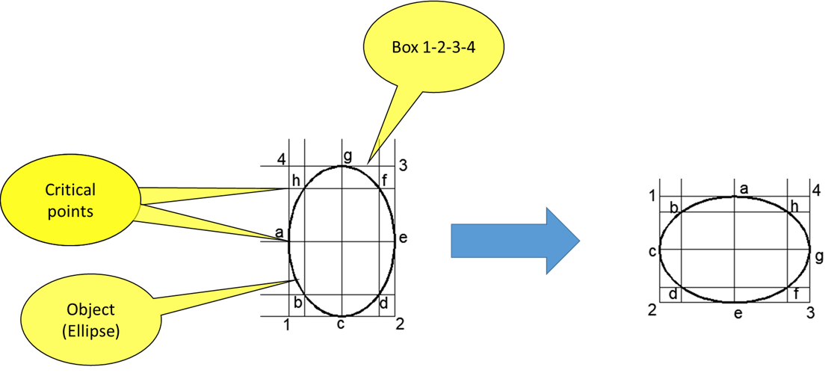
Methods to rotate and transfer objects without distortion
BOX METHOD
Engulf the object with a box
Mark all critical points
Construct the box at the required location
Transfer the critical points on it
And redraw the required object

Slide 8
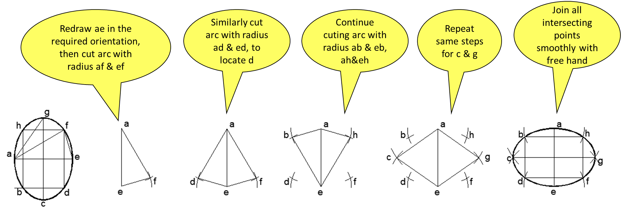
DISTANCE METHOD
Works on the principle of location of third point with respect to existing two points constructing a triangle
Transfer the main line at the required orientation
Mark two critical points on it
Locate the distance of third point with respect to its distance from the two points by cutting intersecting arcs using compass
Carry out the same procedure for other points
If the object is symmetric, many distances will be equal, so at one setting of compass many arcs at relevant positions can be cut thus saving time
Join all the intersections

